Slide 1

Portable NMR Spectroscopy with Direct Sampling
BASc. Thesis
Kevin Kim
Supervisor: Professor Roman Genov
Notes:
Hello!
My name is Kevin and I will be talking to you about my thesis project
In this presentation, I will propose a receiver and digital signal processing system to be used in portable NMR spectroscopy.

Slide 2
Outline
Background
Analog Front-End Design
Digital Back-End Design
Integration & Results
Summary
Notes:
This is an outline of the presentation.
I will touch on the background and motivation first, then move on to the two different fields of design for this project.
I will then talk about the integration of the two designs, then finish with a discussion of results and a summary.

Slide 3
Outline
Background
Analog Front-End Design
Digital Back-End Design
Integration & Results
Summary
Notes:
Before we get into the details of my prosed design, lets start with the background of NMR Spectroscopy

Slide 4
Background
NMR Spectroscopy
Applications
A chemical analysis tool used in a broad array of fields
Chemistry
Biomedicine
Food safety
Recent emergence of portable spectrometers
In-vivo biomedical studies
On-field autonomous monitoring systems
Lepre et al. Chem Rev, 2004 (J.W.Peng group, Univ. Notre Dame)
Laghi et al. TrAC, 2014 (Capozzi group, Univ. Bologna)
Ha et al. PNAS, 2014 (Ham group, Univ. Harvard)
Handwerker et al. Nature Methods, 2020 (Scheffler group, Univ. Tübingen)
Notes:
NMR Spectroscopy is a chemical analysis tool used in a variety of fields from biomedicine, food safety, to of course, chemistry.
Conventional spectrometers are large, complicated machines housed and supported in large facilities.
However, there has been an emergence of portable spectrometers, aimed at in-vivo biomedical studies or on-field autonomous monitoring systems for quality control

Slide 5
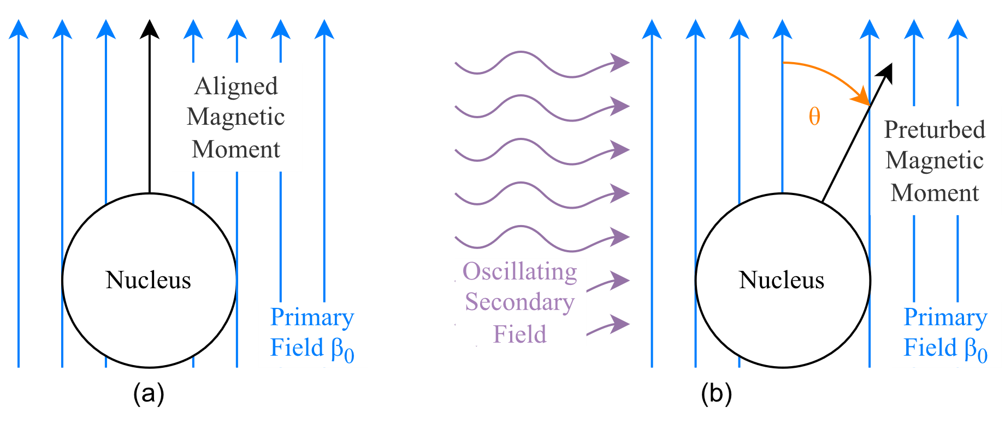
Background
NMR Spectroscopy
Theory pt. 1
(a) Nucleus aligned by primary $β_{0}$ magnetic field. (b) Nucleus disturbed by secondary oscillating magnetic field
Singh. Characterization of Polymers and Fibres, Woodhead Publishing 2022 (Book).
Notes:
NMR Spectroscopy is performed by first applying a static primary magnetic field $β_{0}$ to a given sample.
This aligns spin of the nucleus to that primary field.
A secondary oscillating magnetic field is then applied orthogonally to the primary field.
This perturbs the alignment of the nucleus, and it transitions to a higher energy state.
When this secondary oscillating field is removed the nucleus re-aligns with the primary field, the energy is released as a signal as the nucleus returns to the lower energy state.
This signal is referred to as the NMR signal

Slide 6
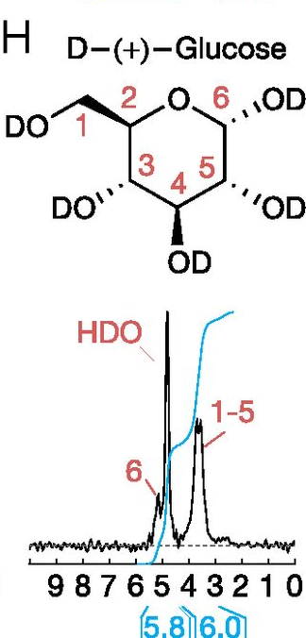
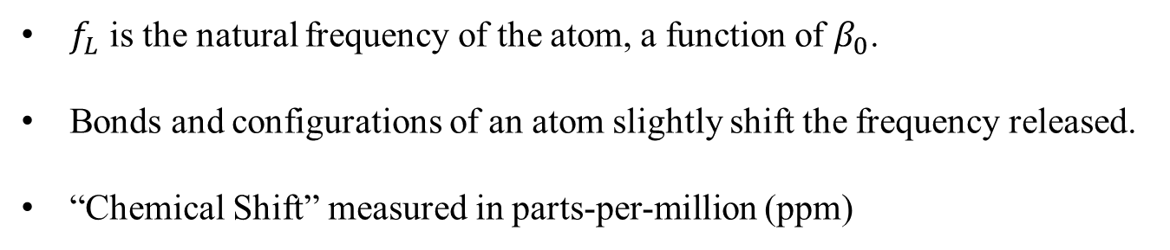

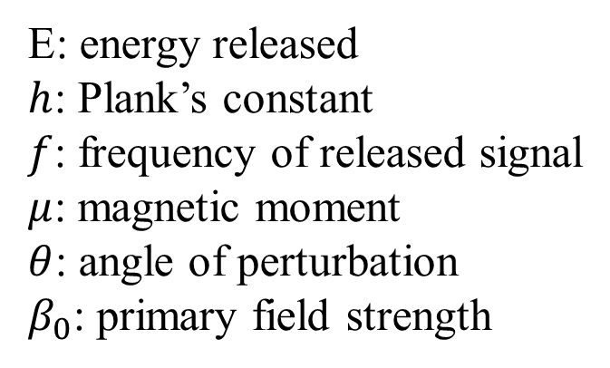
Background
NMR Spectroscopy
Theory pt. 2
E: energy released
$h$: Plank’s constant
$f$: frequency of released signal
$μ$: magnetic moment
$θ$: angle of perturbation
$β_{0}$: primary field strength
$$\left|E\right|=hf=μβ_{0}cos\left(θ\right)$$
$f_{L}$ is the natural frequency of the atom, a function of $β_{0}$.
Bonds and configurations of an atom slightly shift the frequency released.
“Chemical Shift” measured in parts-per-million (ppm)
NMR Spectrum of Glucose
Ha et al. PNAS, 2014 (Ham group, Univ. Harvard)
Singh. Characterization of Polymers and Fibres, Woodhead Publishing 2022 (Book).
Notes:
The frequency of the NMR signal is proportional to the primary magnetic field strength.
The signal released by an unbound nucleus of an element is referred to as the Larmor Frequency $f_{L}$, but properties such as the bonds associated with a nucleus in a molecule will shift the frequency of the signal slightly from this Larmor frequency.
These shifts referred to as Chemical Shifts measured in parts per million

Slide 7
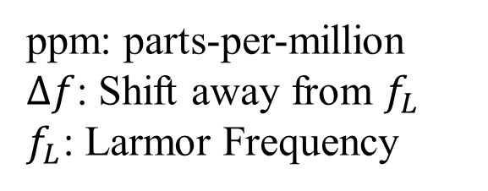
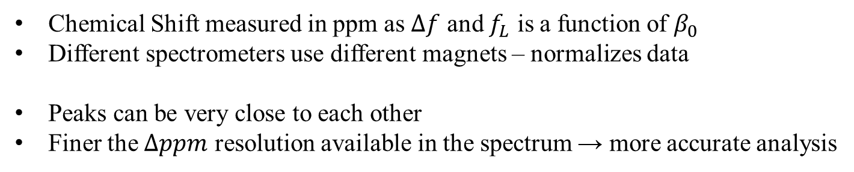

Background
NMR Spectroscopy
Theory pt. 3
ppm: parts-per-million
$Δf$: Shift away from $f_{L}$
$f_{L}$: Larmor Frequency
$$ppm=\frac{Δf}{f_{L}}∗{10}^{6}$$
Chemical Shift measured in ppm as $Δf$ and $f_{L}$ is a function of $β_{0}$
Different spectrometers use different magnets – normalizes data
Peaks can be very close to each other
Finer the $Δppm$ resolution available in the spectrum → more accurate analysis
NMR Spectrum of Glucose
Ha et al. PNAS, 2014 (Ham group, Univ. Harvard)
Singh. Characterization of Polymers and Fibres, Woodhead Publishing 2022 (Book).
Notes:
Here we can see the conversion of the shifted frequency to units of ppm
As the frequency is proportional to the primary magnetic field strength, different spectrometers with different magnets and strengths will have a different $f_{L}$ for the same element.
In addition, the shifts away from the Larmor frequency will also be proportional to the magnetic field strength.
ppm as a unit effectively normalizes the shifts across different spectrometers. It measures the ratio of the shift relative to the Larmor frequency and is therefore agnostic to $β_{0}$
For a typical NMR spectrometer, distinctions of peaks lower than 5 ppm is a requirement.
The accuracy of an analysis is then a function of how fine-grain the shifts in the frequency can be detected compared to the Larmor frequency.
Hence, stronger magnets are typically used for accurate spectroscopy. The stronger a magnet is, the larger the larger the shifts in frequency for a given ppm, making it easier to achieve accuracy without hyper-fine detection of shifts.

Slide 8

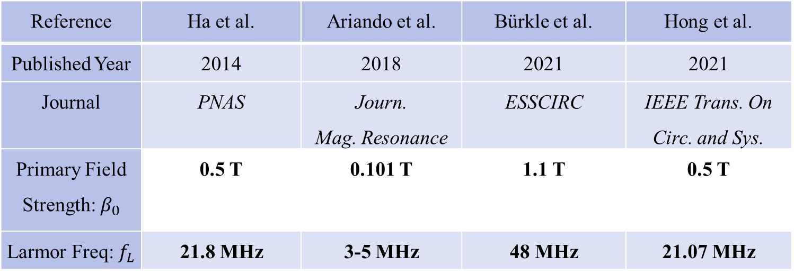
Background
State of Art
Larmor Freq.
$$\left|E\right|=hf=μβ_{0}cos\left(θ\right)$$
Reference | Ha et al. | Ariando et al. | Bürkle et al. | Hong et al.
Published Year | 2014 | 2018 | 2021 | 2021
Journal | PNAS | Journ. Mag. Resonance | ESSCIRC | IEEE Trans. On Circ. and Sys.
Primary Field Strength: $β_{0}$ | 0.5 T | 0.101 T | 1.1 T | 0.5 T
Larmor Freq: $f_{L}$ | 21.8 MHz | 3-5 MHz | 48 MHz | 21.07 MHz
Ha et al. PNAS, 2014 (Ham group, Univ. Harvard)
Ariando et al. Journ. of Mag. Resonance, 2019 (S.Mandal group, Univ. Western Reserve)
Bürkle et al. ESSCIRC, 2021 (J.Anders group, Univ. Stuttgart)
Hong et al. IEEE Trans. on Circ. and Sys., 2021 (N.Sun group, Univ. Tsinghua)
Notes:
In contrast, state-of-art portable NMR system comprise on accuracy by utilizing weaker, but more portable magnets.
State of art systems use field strengths below or around 1 Tesla, resulting in relatively low Larmor frequencies.
This means that for a given ppm, the size of the shift in frequency is reduced.
This limits the accuracy achievable by state-of-art portable systems, as peaks can be difficult to differentiate when they are so close together.

Slide 9
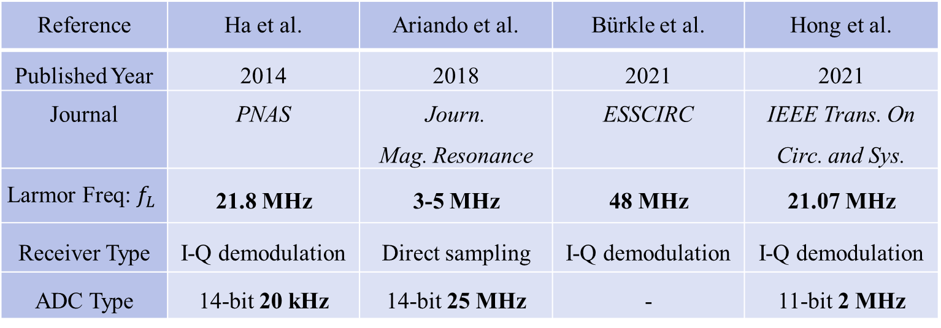
Background
State of Art
NMR Receivers
Reference | Ha et al. | Ariando et al. | Bürkle et al. | Hong et al.
Published Year | 2014 | 2018 | 2021 | 2021
Journal | PNAS | Journ. Mag. Resonance | ESSCIRC | IEEE Trans. On Circ. and Sys.
$$\text{Larmor} \text{Freq}\text{: }f_{L}$$ | 21.8 MHz | 3-5 MHz | 48 MHz | 21.07 MHz
Receiver Type | I-Q demodulation | Direct sampling | I-Q demodulation | I-Q demodulation
ADC Type | 14-bit 20 kHz | 14-bit 25 MHz | - | 11-bit 2 MHz
Ha et al. PNAS, 2014 (Ham group, Univ. Harvard)
Ariando et al. Journ. of Mag. Resonance, 2019 (S.Mandal group, Univ. Western Reserve)
Bürkle et al. ESSCIRC, 2021 (J.Anders group, Univ. Stuttgart)
Hong et al. IEEE Trans. on Circ. and Sys., 2021 (N.Sun group, Univ. Tsinghua)
Notes:
Another way that state-of-art systems are constrained is by slow analog to digital converters, ADCs
Most state-of-art systems have ADC that rarely meet the Nyquist criteria for digital signals, which states that sampling frequency for a singal must be at least twice that of the highest frequency in the signal to be able to fully reconstruct a signal.
State-of-art systems instead circumvent this criteria by having complicated analog receivers, Rx, which utilize complex techniques such as I-Q demodulation to reduce the sampling frequency required.
While complex Rx offers the ability to sample at a lower frequency, it also becomes an avenue for noise and distortion to be introduced to the circuit.

Slide 10
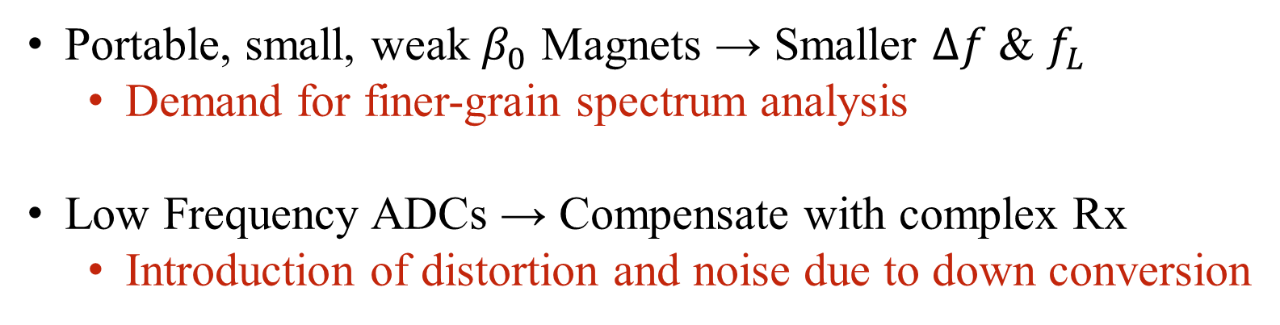
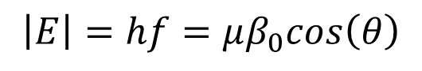
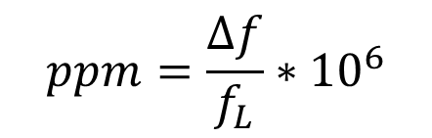
Background
State of Art
Summary
$$ppm=\frac{Δf}{f_{L}}∗{10}^{6}$$
$$\left|E\right|=hf=μβ_{0}cos\left(θ\right)$$
Portable, small, weak $β_{0}$ Magnets → Smaller $Δf$ & $f_{L}$
Demand for finer-grain spectrum analysis
Low Frequency ADCs → Compensate with complex Rx
Introduction of distortion and noise due to down conversion
Notes:
So. To summarize:
State-of-art designs are limited by portable, small and weak magnets which result in a small shift in frequency as well as a lower Larmor frequency.
This means that to increase accuracy, there is a demand for finer-grain spectrum analysis capable of detecting very small shifts in frequency.
State-of-art designs are also limited by low frequency ADCs, which compensate with a complex receiver.
This complexity however may introduce distortion and noise into the system, that limit the accuracy of fine grain spectrum analysis.

Slide 11
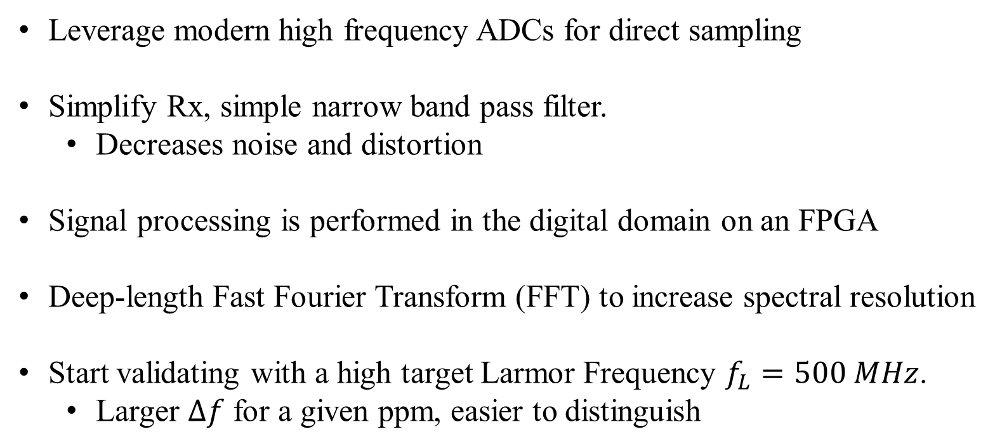
Background
Motivation
Leverage modern high frequency ADCs for direct sampling
Simplify Rx, simple narrow band pass filter.
Decreases noise and distortion
Signal processing is performed in the digital domain on an FPGA
Deep-length Fast Fourier Transform (FFT) to increase spectral resolution
Start validating with a high target Larmor Frequency $f_{L}=500 MHz$.
Larger $Δf$ for a given ppm, easier to distinguish
Notes:
To solve these two limitations, this project aims to leverage modern high frequency ADCs to direct sample the signal.
This will allow a simplification of the Rx to reduce noise and distortion such that fine-grain analysis of the signal can be performed.
Once acquired, the signal will be processed in the digital domain.
A deep-length Fast Fourier Transform will be implemented on an FPGA
To validate this motivation, the target Larmor frequency will be set to 500 MHz, as it will result in a larger frequency shift for a given target ppm, making it easier to distinguish.

Slide 12
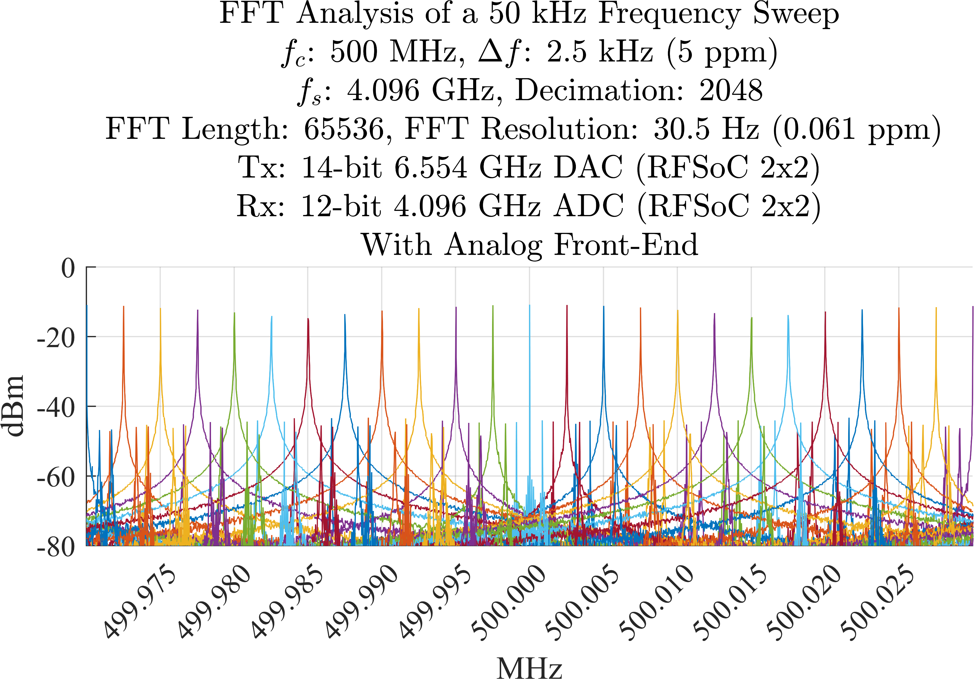
Background
Contribution
Superimposed plots of the FFT performed by the system during a frequency sweep
FFT performed in FPGA Hardware
Achieved FFT resolution of 0.06 ppm
Spectroscopy can detect distinct peaks below 5 ppm
Notes:
Here is a glimpse of what was achieved by the system.
Here we see superimposed plots of FFTs performed by the system during a frequency sweep.
The achieved minimum FFT resolution of 0.06 ppm.
The system was able to display distinct peaks at intervals of 5 ppm

Slide 13
Outline
Background
Analog Front-End Design
Digital Back-End Design
Integration & Results
Summary
Notes:
With those results in mind, lets move on to how it was implemented.
I will start with the analog front-end design.

Slide 14
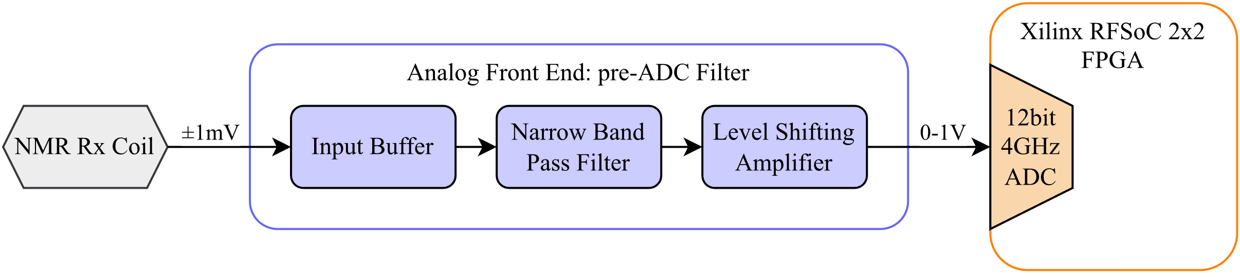
Front-End
Proposed Design
High level block diagram of an NMR analog front-end
Notes:
This is a high-level block diagram of the NMR analog-front end.
On the left, there is an NMR Rx Coil – the source of the NMR Signal
On the right sits the Xilinx RFSoC2x2 FPGA, the digital platform onto which the digital back-end will be implemented.
This FPGA freatures a high frequency ADC that will act as the end point to the analog front-end.
Between the NMR Coil and the FPGA, this project proposes a pre-ADC Filter circuit.
This filter is comprised of three stages: the Input buffer, the Narrow Band Pass filter, and the Level shifting amplifier.

Slide 15
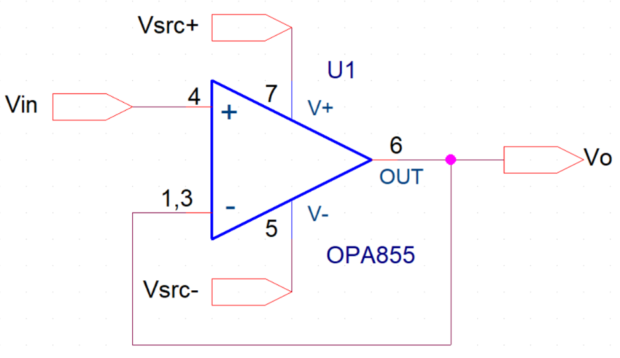
Front-End
Input Buffer Design
Circuit diagram of the input buffer
Texas Instruments OPA855 transimpedance amplifiers are used for all stages.
8 GHz gain bandwidth, 8x greater than Nyquist requirement for $f_{L}=500 MHz$
Notes:
The goal of this input buffer is to provide a high input impedance seen by the NMR Coil to ensure that the circuit does not interfere with signal acquisition.
It is a simple unity gain amplifier configuration, implemented with the Texas Instruments OPA8555 transimpedance amplifier.
And it was chosen for its 8 GHz gain bandwidth, 8x greater than the Nyquist requirement for a Larmor frequency set to 500 MHz
All stages of the front-end will utilize this Opamp

Slide 16
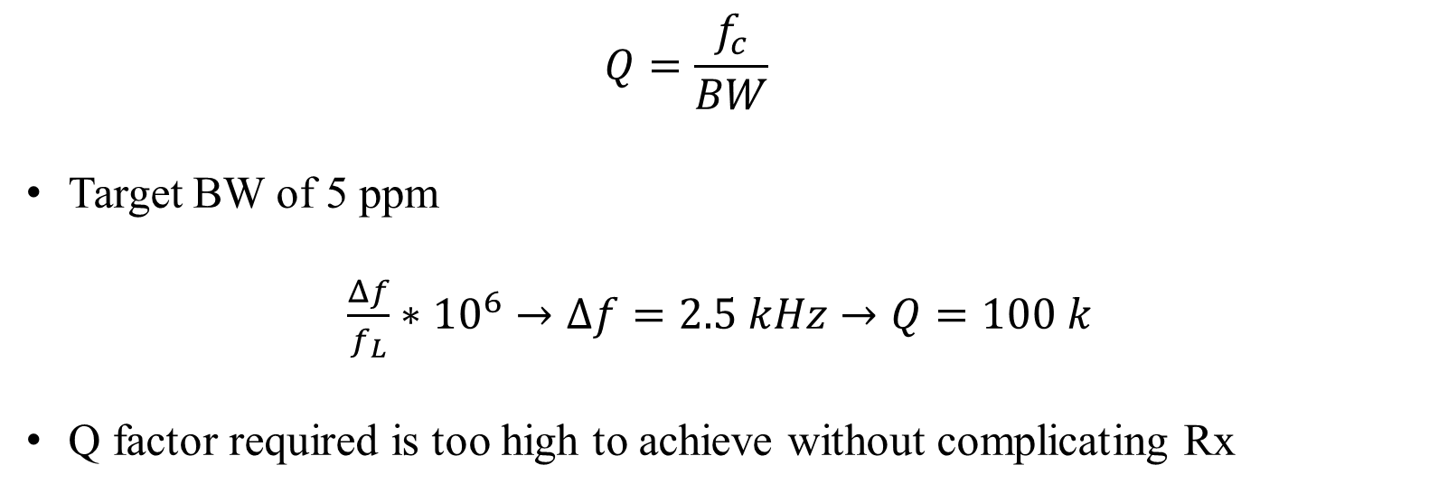
Front-End
NBPF Design
Q-Factor
$$Q=\frac{f_{c}}{BW}$$
Target BW of 5 ppm
$\frac{Δf}{f_{L}}∗{10}^{6}→Δf=2.5 kHz→Q=100 k$
Q factor required is too high to achieve without complicating Rx
TI Designs, High-Q Active Differential Band-Pass Filter Reference (Web Article)
Notes:
The goal of the NBPF would be to eliminate noise from frequencies outside of the relevant bandwidth.
When designing the NBPF, a metric to consider is the Q factor, which describes how narrow the bandwidth provided by filter is.
The higher this factor, the narrower the bandwidth of the filter becomes. As we want to eliminate frequencies outside of the relevant bandwidth, we want to design the Q factor for the desired bandwidth.
However, with a BW target in the range of 5 ppm, Q would be extremely high, in the range of hundreds of thousands.
Such a narrow filter is an unrealistic goal, especially if we keep in mind the design principle of keeping the Rx simple.

Slide 17
Front-End
NBPF Design
Approach
Compromised approach
Aim for a lower yet realistic Q factor
Reduce intermodulation and distortion from non-relevant frequencies
Process signal in the digital domain
Notes:
As a result, a compromised approach was taken
Instead of aiming for such a high Q, we would aim for a lower but realistic Q factor
The goal would be to reduce intermodulation and distortion from non-relevant frequencies as much as possible, and to then apply higher order narrower filters in the digital domain, where implementation of such a narrow filter is easier than in the analog domain.

Slide 18
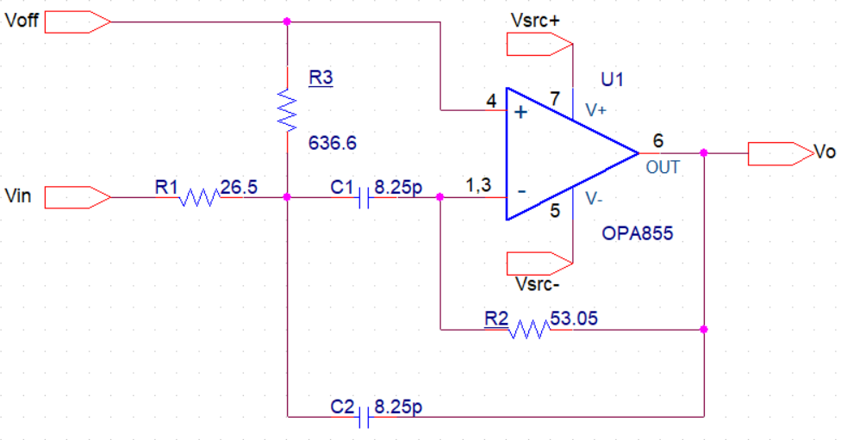
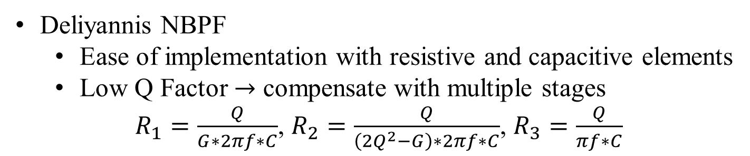
Front-End
NBPF Design
Deliyannis
Circuit diagram of the Deliyannis NBPF
Deliyannis NBPF
Ease of implementation with resistive and capacitive elements
Low Q Factor $→$ compensate with multiple stages
$R_{1}=\frac{Q}{G∗2πf∗C}$, $R_{2}=\frac{Q}{\left(2Q^{2}−G\right)∗2πf∗C}$, $R_{3}=\frac{Q}{πf∗C}$
TI Designs, High-Q Active Differential Band-Pass Filter Reference (Web Article)
Notes:
The Deliyannis Narow Band Pass Filter was chosen as the chosen configuration,
This was due to its ease of implementation with only resistive and capacitive elements.
The downside of this configuration was the relatively low Q factor achievable. Hence, this would have to be compensated with multiple stages.
Three stages of this configuration were chained to achieve a higher Q factor.

Slide 19
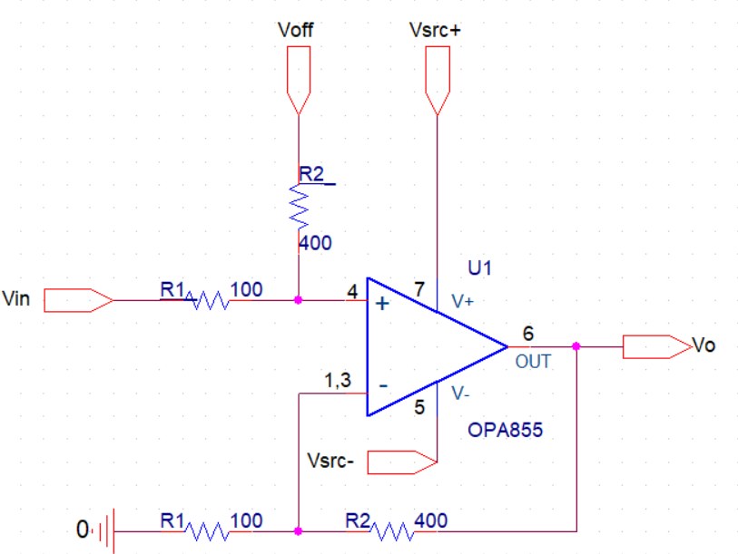
Front-End
Level Shifter
Circuit diagram of the level shifting amplifier
Notes:
The level shifting amplifier’s goal is to amplify and shift the output voltage as to match the input range of the ADC on the Xilinx RFSoC2x2 board.
This was implemented by a simple non-inverting configuration, with a reference voltage to provide input voltage range matching to the ADC.

Slide 20
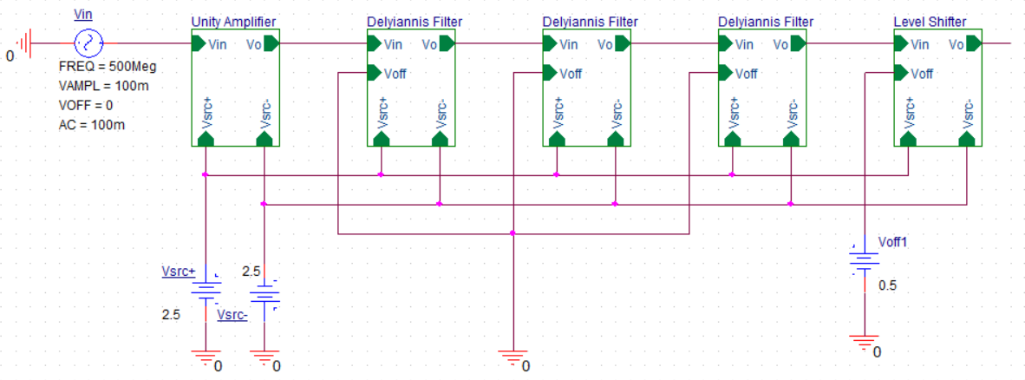
Front-End
Full System Diagram
Circuit diagram of the front-end detailing the sub-circuits
Notes:
Here we can see the final system diagram.
You will see the unity gain amplifier, followed by the three delyiannis filters, then the level shifter.

Slide 21
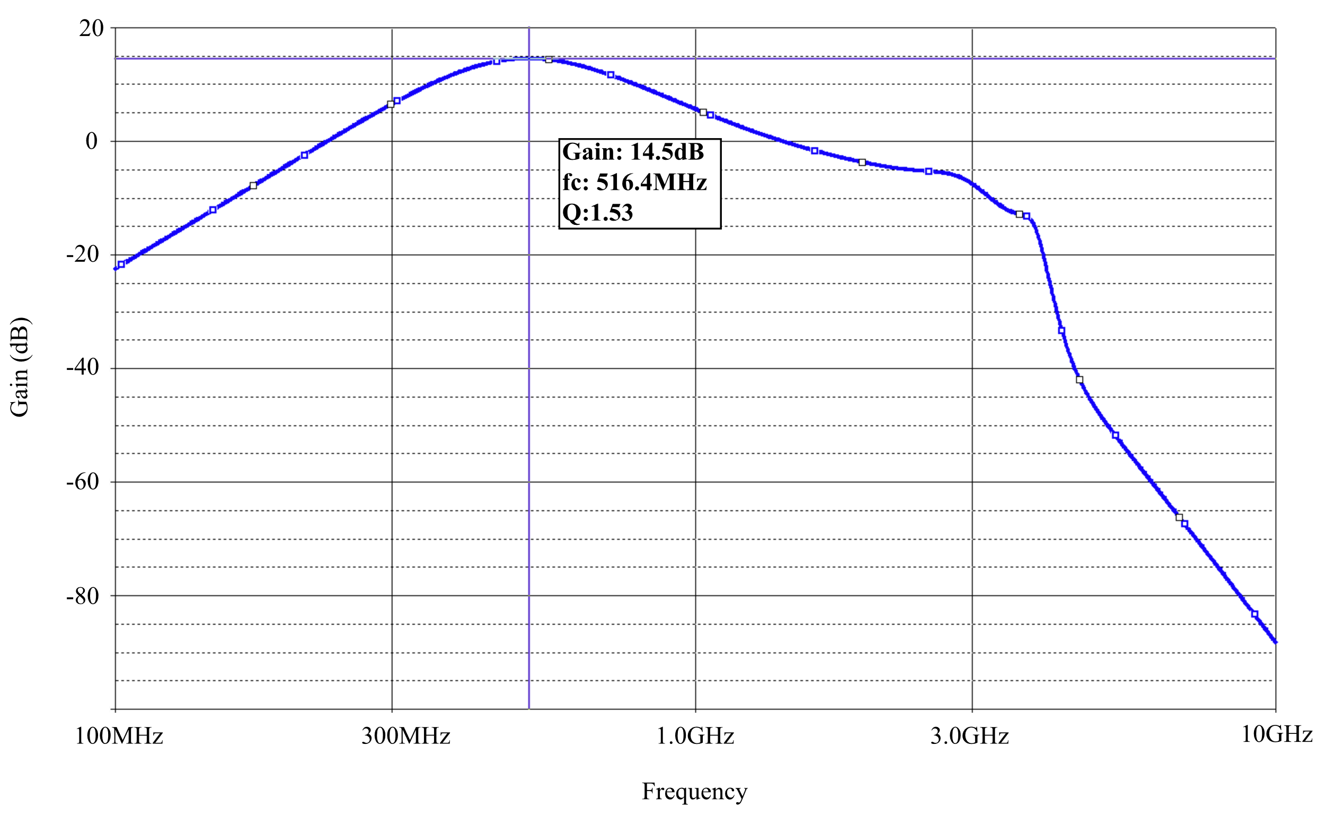
Front-End
Full System Simulation
Frequency response of the analog front-end
Notes:
The simulated frequency response achieved a final gain of 14.5 dB centered at 516.4 MHz, with a Q factor of 1.53
The Q achieved here is relatively low compared to what was desired, but due to dominant parasitic effects at this range, high Qs were difficult to achieve.
We could also further add stages but this would add complexity to the Rx which was undesirable.

Slide 22
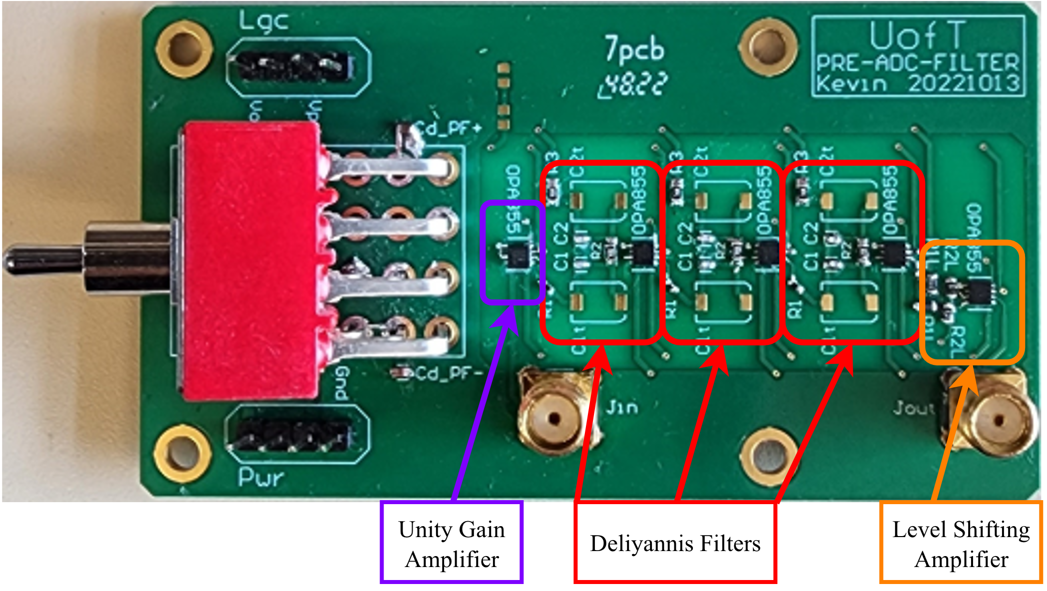
Front-End
Assembled Design
Image of the assembled front-end
Notes:
Here is an image of the fully assembled PCB.
Each stage has been highlighted in the diagram.

Slide 23
Outline
Background
Analog Front-End Design
Digital Back-End Design
Integration & Results
Summary
Notes:
Moving on to the digital data processing

Slide 24
Back-End
Platform
Xilinx RFSoC 2x2 platform
12-bit 4.096 GHz ADC
ZYNQ Ultrascale+ MPSoC Processor
Dedicated processor for control and user interaction
FPGA Programmable Logic (PL) for custom hardware
Processor hosts Linux based OS
Interacts with hardware implemented in PL by drivers and Python APIs
Notes:
The digital back-end is built onto the Xilinx RFSoC 2x2 platform which features a 12-bit 4.096 GHz ADC
This board features a ZYNQ Ultrascale+ MPSoC Processor, which includes a dedicated process for control and user interaction, as well as an FPGA Programmable logic to implement custom hardware.
The dedicated processor is configured to run a Linux distribution, and gives the user interaction with the hardware implemented into the FPGA via python APIs.

Slide 25

Back-End
Inspiration
University of Strathclyde - Software Defined Radio Research Laboratory
Modification of StrathSDR’s mixer-based Zoom FFT
https://github.com/strath-sdr/rfsoc_sam
Notes:
The design was inspired by the mixer-based zoom FFT implemented by StrathSDR, the University of Strathclyde’s software defined radio research lab.
The proposed back-end is a modification of this design to support an increased length of the FFT window.
The FFT is implemented in hardware, and is performed in three separate stages

Slide 26
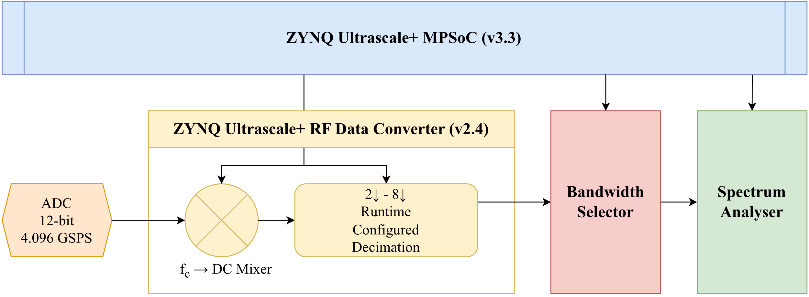
Back-End
Data Converter
Block diagram of the digital back-end: signal chain of the RF data acquisition and processing
Notes:
The first stage is the ZYNQ Ultrascale+ RF Data Converter
This block controls dedicated hardware outside of the FPGA logic, responsible for data acquisition through the ADC.
After acquisition from the ADC, the hardware performs Mixing to bring a target frequency to DC.
This is done to effectively “focus” the window of the FFT and center the analysis at the Larmor Frequency, and effectively allows higher levels of decimations.
The signal is then decimated up to a factor of 8. The level of decimation acts to control the bandwidth of the FFT Window.
Both the mixing center frequency and the decimation is controllable at runtime by the MPSoC processor.
The data converter hardware then sends the processed data to the FPGA logic in packets.

Slide 27
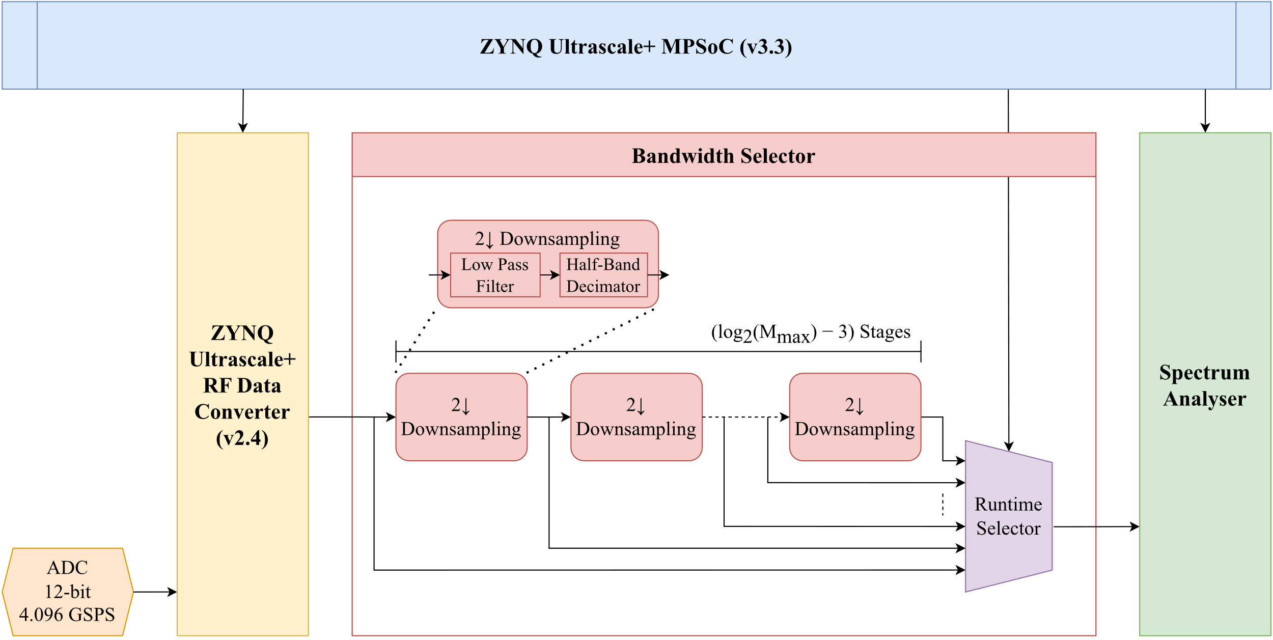
Back-End
Bandwidth Selector
Block diagram of the digital back-end: signal chain of the bandwidth selector
Notes:
The bandwidth selector is implemented in the FPGA logic fabric and is the second stage of the digital back-end system
It is used to provide a level of decimation greater the factor of 8 provided by the data converter.
It consists of a series of down samplers, each consisting of a low pass filter and half-band decimators.
Each stage of these down samplers multiply the factor of decimation by 2.
The output at each of these down samplers are given to a runtime selector, to give control over the level of decimation at runtime.

Slide 28
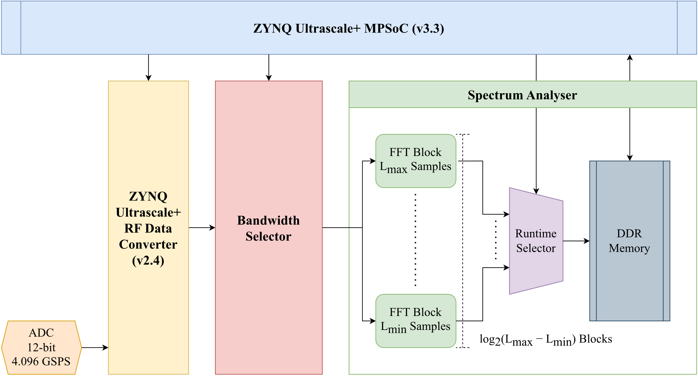
Back-End
Spectrum Analyser
Block diagram of the digital back-end: signal chain of the spectrum analyser
Notes:
The spectrum analyser is the third and final stage of the digital back-end.
It contains multiple FFT blocks, each capable of FFTs of different lengths.
The outputs of these blocks are fed into a runtime selector to give control over the length of FFT performed at runtime.

Slide 29
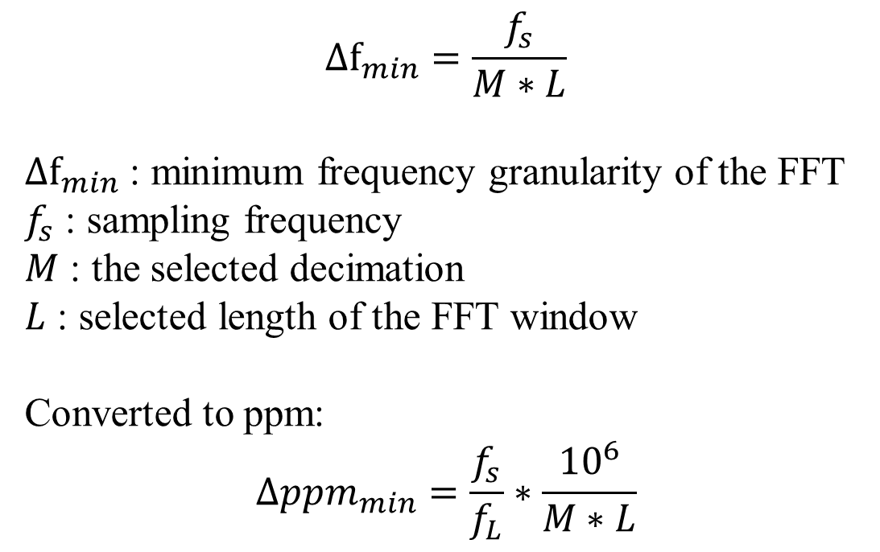
Back-End
Spectral Resolution
Equations
$$Δf_{min}=\frac{f_{s}}{M∗L}$$
$Δf_{min}$ : minimum frequency granularity of the FFT
$f_{s}$ : sampling frequency
$M$ : the selected decimation
$L$ : selected length of the FFT window
Converted to ppm:
$$Δppm_{min}=\frac{f_{s}}{f_{L}}∗\frac{{10}^{6}}{M∗L}$$
Notes:
Under this system, the spectral resolution of the FFT window is governed by the following equation and is a function of the level of decimation and the length of the FFT window.
Both increasing lengths of FFT and increasing the level of decimation will result in finer levels of frequency shifts detectable by the FFT.

Slide 30
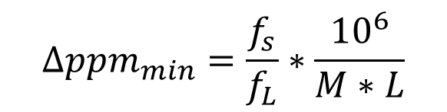
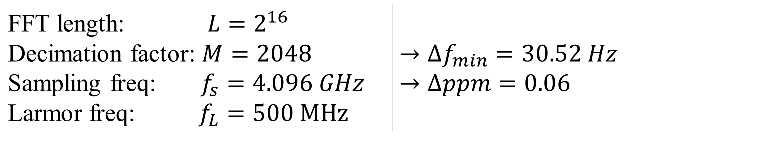
Back-End
Spectrum Resolution
Calculations
$$Δppm_{min}=\frac{f_{s}}{f_{L}}∗\frac{{10}^{6}}{M∗L}$$
FFT length: $L=2^{16}$ Decimation factor: $M=2048$ Sampling freq: $f_{s}=4.096 GHz$ Larmor freq: $f_{L}=500 MHz$ | $→Δf_{min}=30.52 Hz$ $→Δppm=0.06$
Notes:
The digital back-end was implemented with FFT lengths of up to 2^16, and decimations up to a max of 2048.
The minimum frequency shift is then to be 30.5 Hz, an equivalent of 0.06 ppm with the Larmor frequency of 500 MHz

Slide 31
Outline
Background
Analog Front-End Design
Digital Back-End Design
Integration & Results
Summary
Notes:
After both systems are designed, it was time to integrate the analog and digital systems.

Slide 32
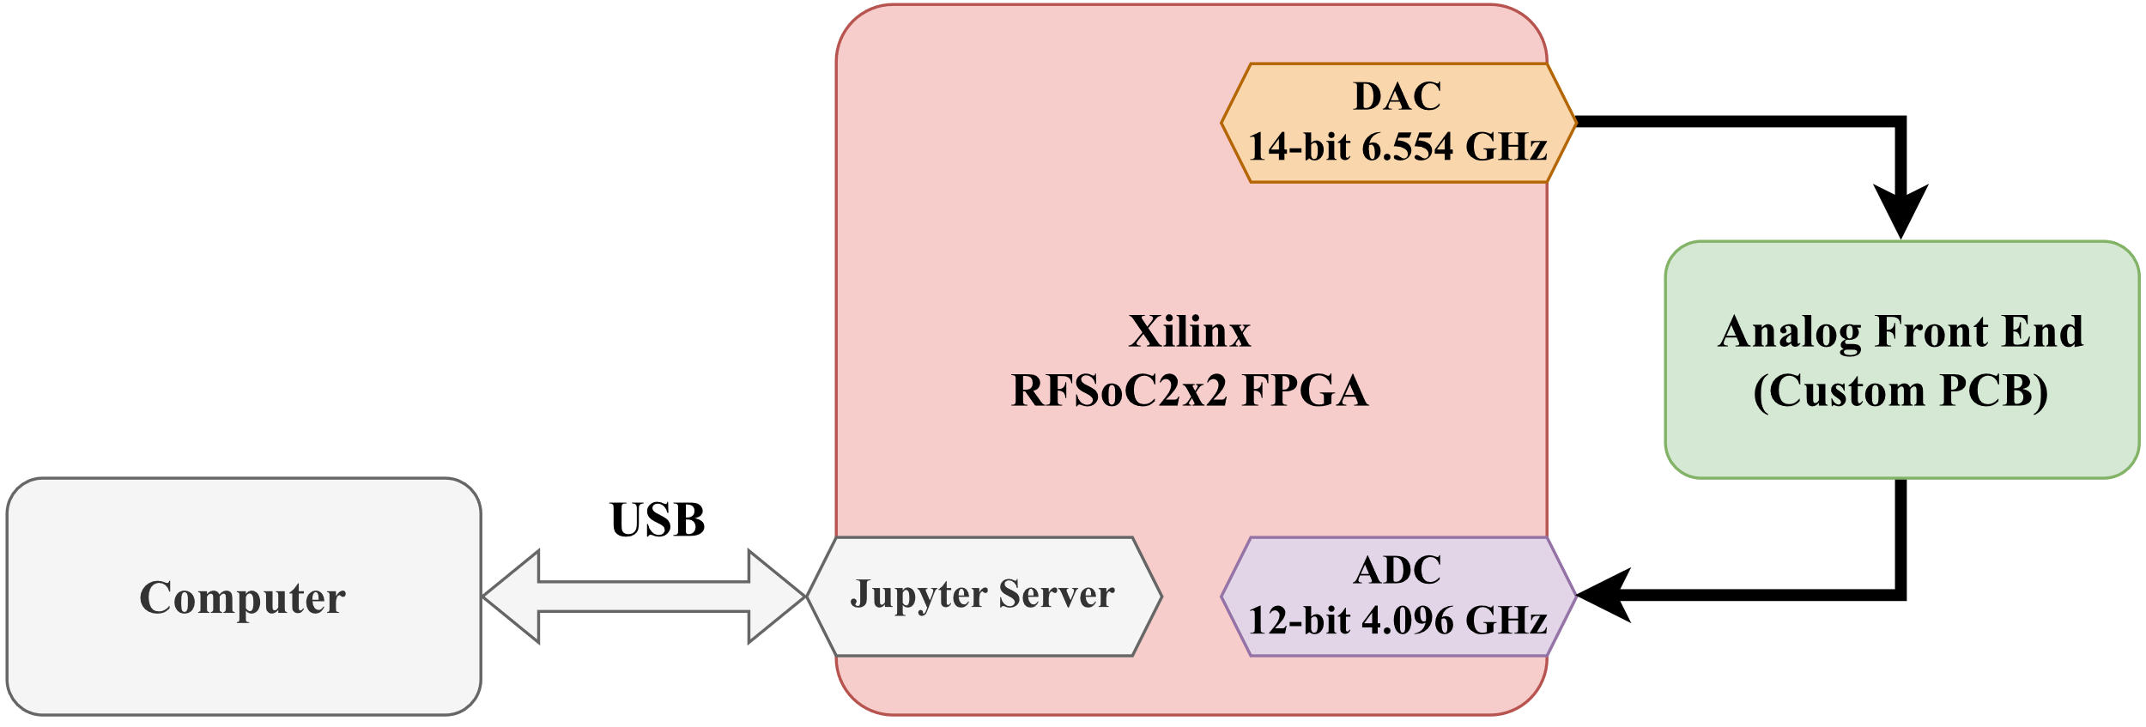
Integration
Setup
Diagram
Block diagram of the experimental integration setup
Notes:
This is a block diagram of the integration setup.
The Xilinx RFSoC 2x2 FPGA also features a digital to analog converter which will be used to generate the test signal. It effectively acts as the transmitter, or Tx of the system.
This test signal will then be input into the analog front end PCB.
The output of the analog front end will then be sampled by the ADC on the FPGA, then processed by the digital back-end.
The RFSoC2x2 board is configured to start a Jupyter Server on boot. This server will be used as the point of interface via a USB to control both the DAC and the digital backend via custom python APIs.

Slide 33
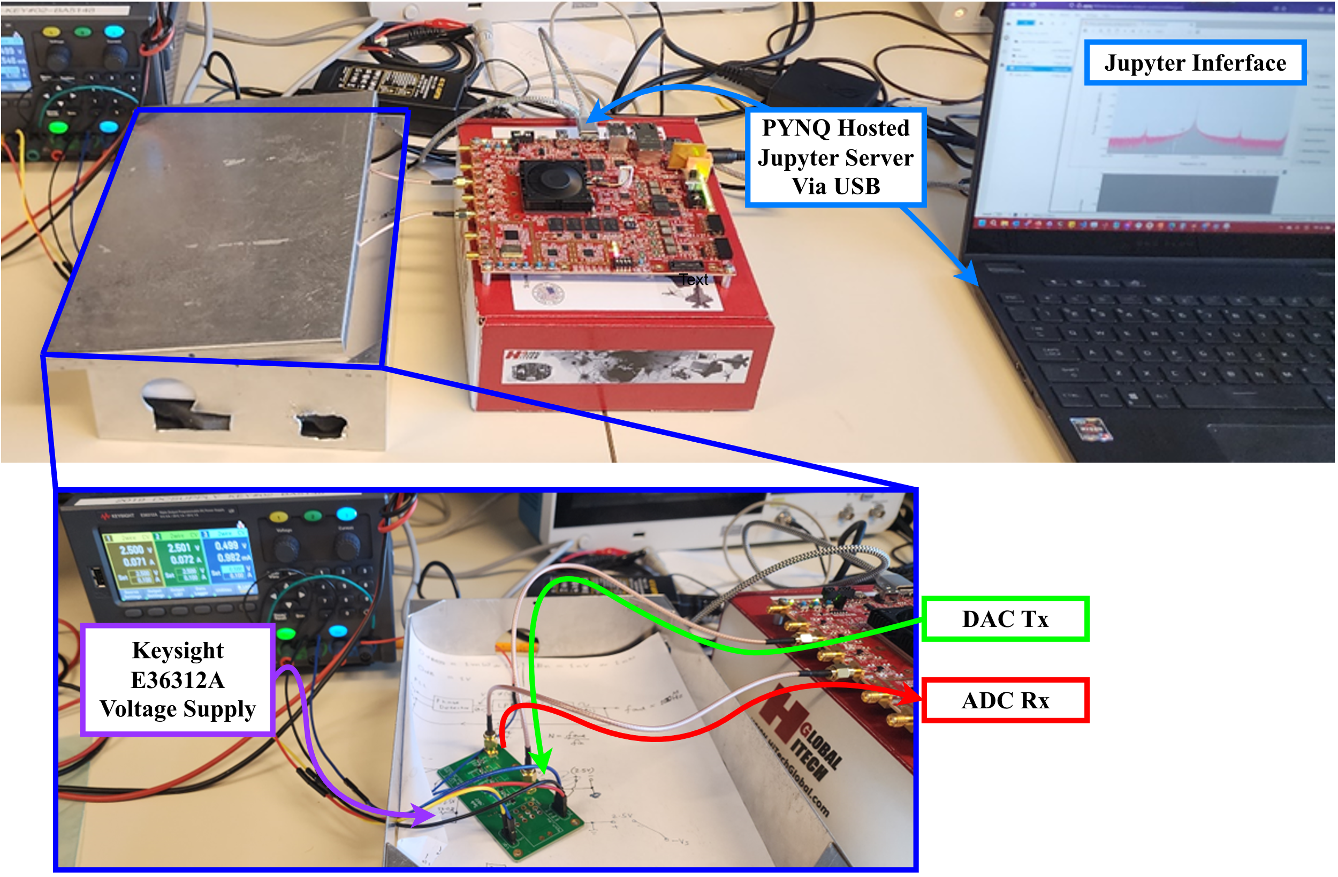
Integration
Setup
Image
Image of the integrated system
Notes:
Here is an image of the physical integration setup.
You can see the custom analog front-end PCB in the metal shielded box.
The FPGA can be seen in the middle of the top image, hosting a Jupyter Server over the USB connection to a laptop

Slide 34
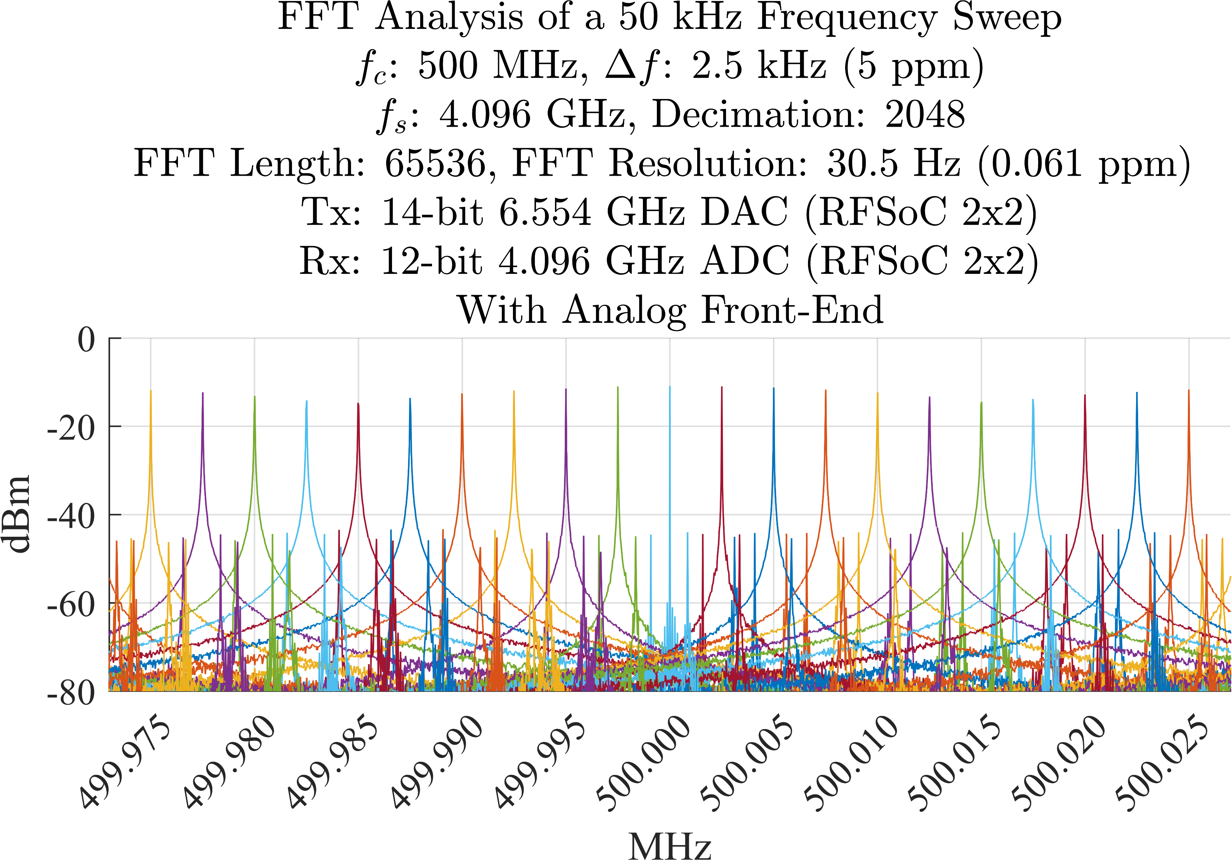
Integration
Test Results
Superimposed plots of the FFTs performed by the system during a frequency sweep
Notes:
As previously shown, this graph shows the super imposed FFTs performed by the integrated system during a frequency sweep.
The width of the sweep is 50 kHz centered around 500 MHz, at intervals of 2.5 kHz, the equivalent of 5 ppm.
As it can be seen, there are clear and distinct peaks observable.
There is however, a secondary row of peaks around -40 dB that may be detrimental to an accurate NMR spectroscopy.

Slide 35
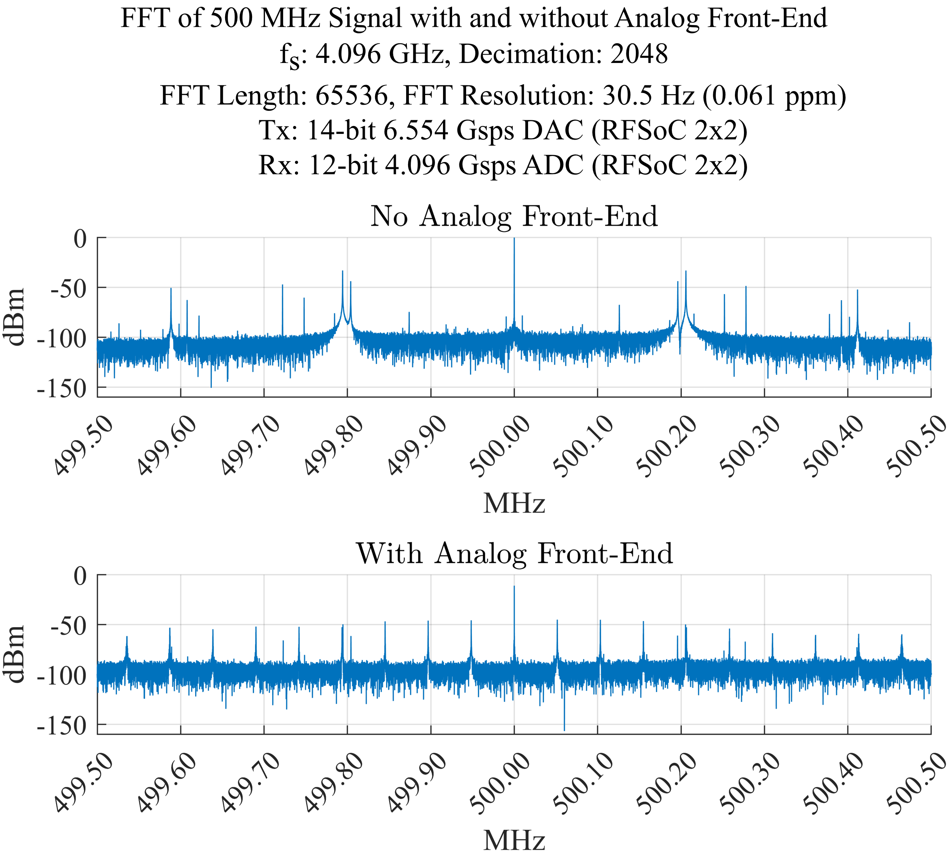
Integration
Front-End Effectiveness
FFT plot with 500 MHz as an input signal with and without the front-end
Notes:
When the individual FFTs with an input signal of 500 MHz are graphed, the source of this second row is more evident.
The above picture shows the FFT performed by the back-end with and without the analog front end.
Without the analog front-end, we can observe side bands at multiples $±0.2 MHz$
With an analog front-end integrated, these peaks are attenuated. This is the desirable outcome, as the filter is supposed to attenuate signals.
However, but there are also more peaks present when the analog front end is integrated.
These additional peaks are likely what is causing the secondary row of peaks observed in the previous plot, and is possibly a result of distortion and intermodulation introduced by the analog circuit.

Slide 36
Outline
Background
Analog Front-End Design
Digital Back-End Design
Integration & Results
Conclusion
Notes:
So to conclude

Slide 37
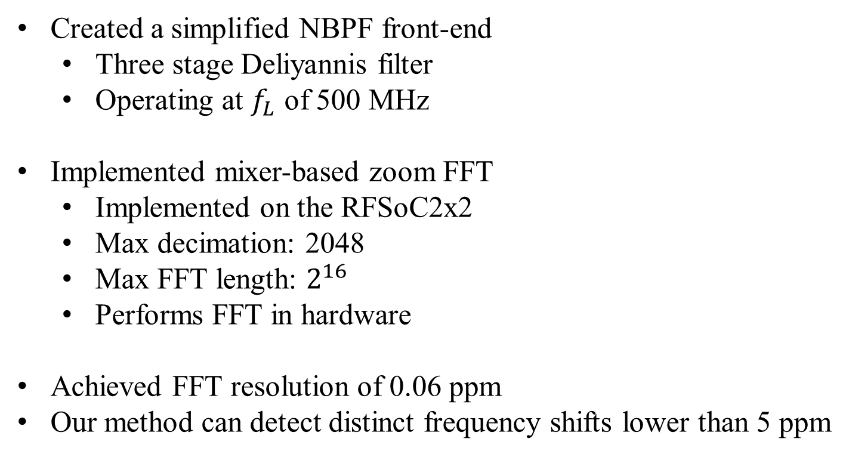
Conclusion
Summary
Created a simplified NBPF front-end
Three stage Deliyannis filter
Operating at $f_{L}$ of 500 MHz
Implemented mixer-based zoom FFT
Implemented on the RFSoC2x2
Max decimation: 2048
Max FFT length: $2^{16}$
Performs FFT in hardware
Achieved FFT resolution of 0.06 ppm
Our method can detect distinct frequency shifts lower than 5 ppm
Notes:
In summary, this project has demonstrated that the approach to direct-sample the NMR signal is viable.
A simplified narrow band pass filter as a was implemented as a front end, with a three stage deliyannis filter operating at 500 MHz.
A mixer-ased zoom FFT was implemented on the RFSoC 2x2 FPGA as a part of the backend – supporting a maximum fft length of 2^16 and maximum decimation of 2048
This resulted in a system capable of achieving a minimum FFT resolution of 0.06 ppm that can easily detect distinct frequency shifts lower than 5 ppm, as typical of NMR systems.

Slide 38
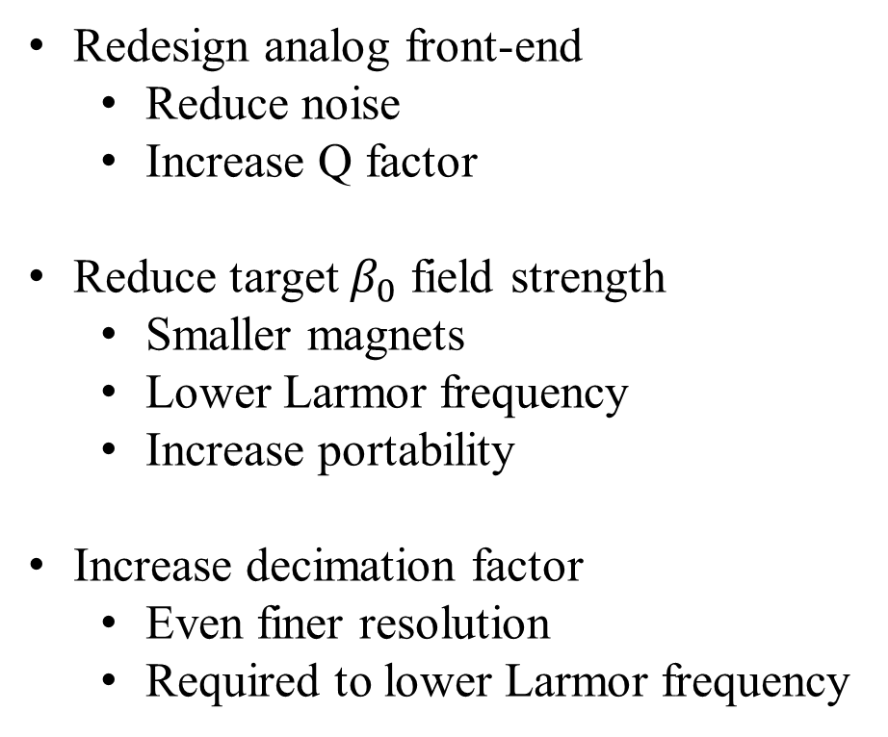
Conclusion
Future Work
Redesign analog front-end
Reduce noise
Increase Q factor
Reduce target $β_{0}$ field strength
Smaller magnets
Lower Larmor frequency
Increase portability
Increase decimation factor
Even finer resolution
Required to lower Larmor frequency
Notes:
In the future, further work will need to be done on the analog front-end.
It should be redesigned to reduce noise and eliminate the additional peaks seen.
The Q factor should also be increased to reduce intermodulation and distortion from non-relevant frequencies.
Given the high-resolution fft achievable by the back-end the target field strength could also be reduced to utilize smaller magnets, lower the larmor frequency and increase portability.
With a lower field strength however, the decimation factor supported by the back-end should also be increased to achieve even finer ppm resolutions.

Slide 39
Conclusion
Conclusion
Thank you for listening
And a special thank you to Sudip Nag
for mentoring me throughout this process.
Notes:
In the future, further work will need to be done on the analog front-end.
It should be redesigned to reduce noise and eliminate the additional peaks seen.
The Q factor should also be increased to reduce intermodulation and distortion from non-relevant frequencies.
Given the high-resolution fft achievable by the back-end the target field strength could also be reduced to utilize smaller magnets, lower the larmor frequency and increase portability.

Slide 40
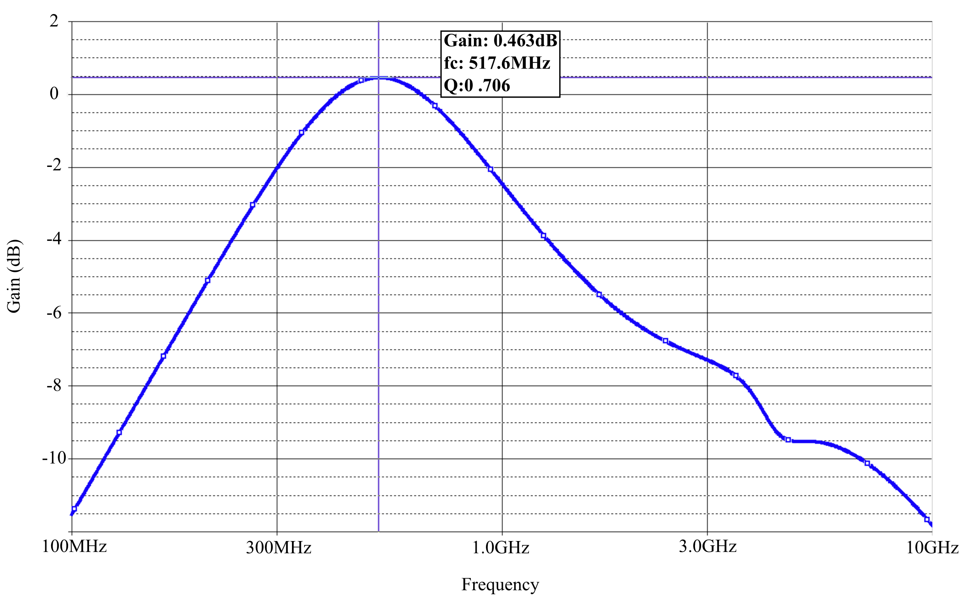
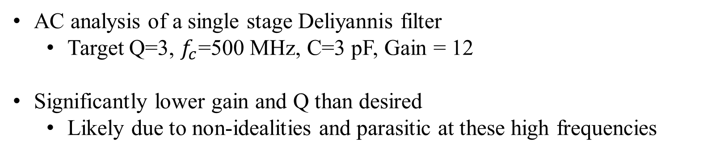
Front-End
NBPF Design
AC analysis of a single stage Deliyannis filter
Target Q=3, $f_{c}$=500 MHz, C=3 pF, Gain = 12
Significantly lower gain and Q than desired
Likely due to non-idealities and parasitic at these high frequencies

Slide 41
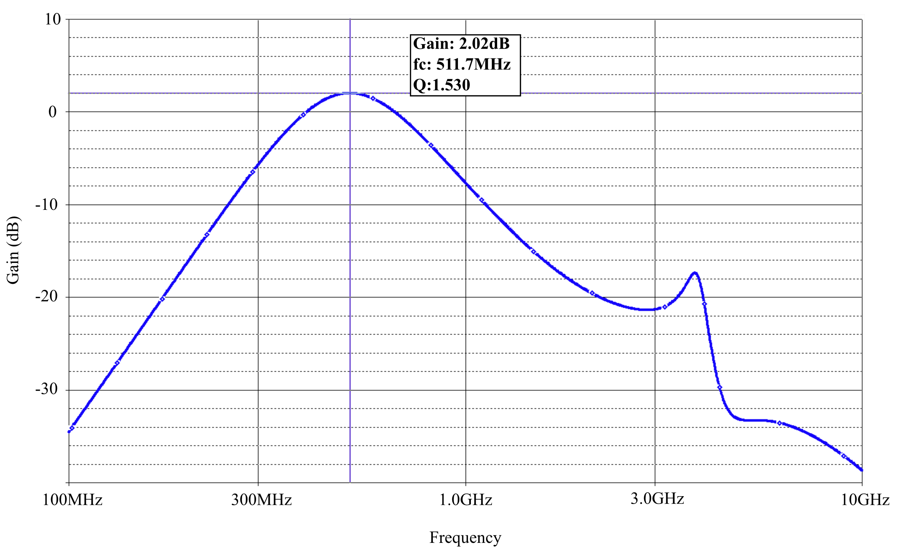
Front-End
NBPF Design
AC Analysis of 3 stages of the Deliyannis filter

Slide 42
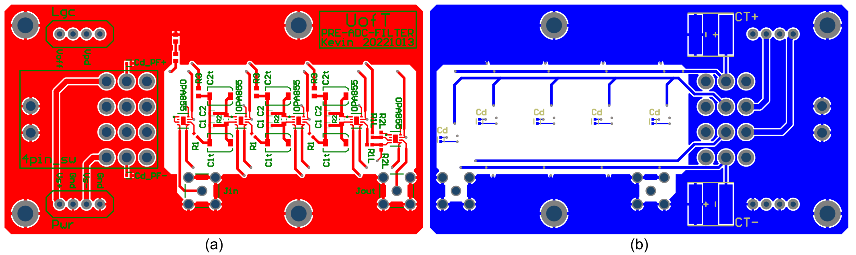
Front-End
Level Shift Design
Care was taken to minimise noise
Components of 0603 or smaller used
Decoupling capacitors at the power inputs of all opamps
Maximised symmetry in traces

Slide 43
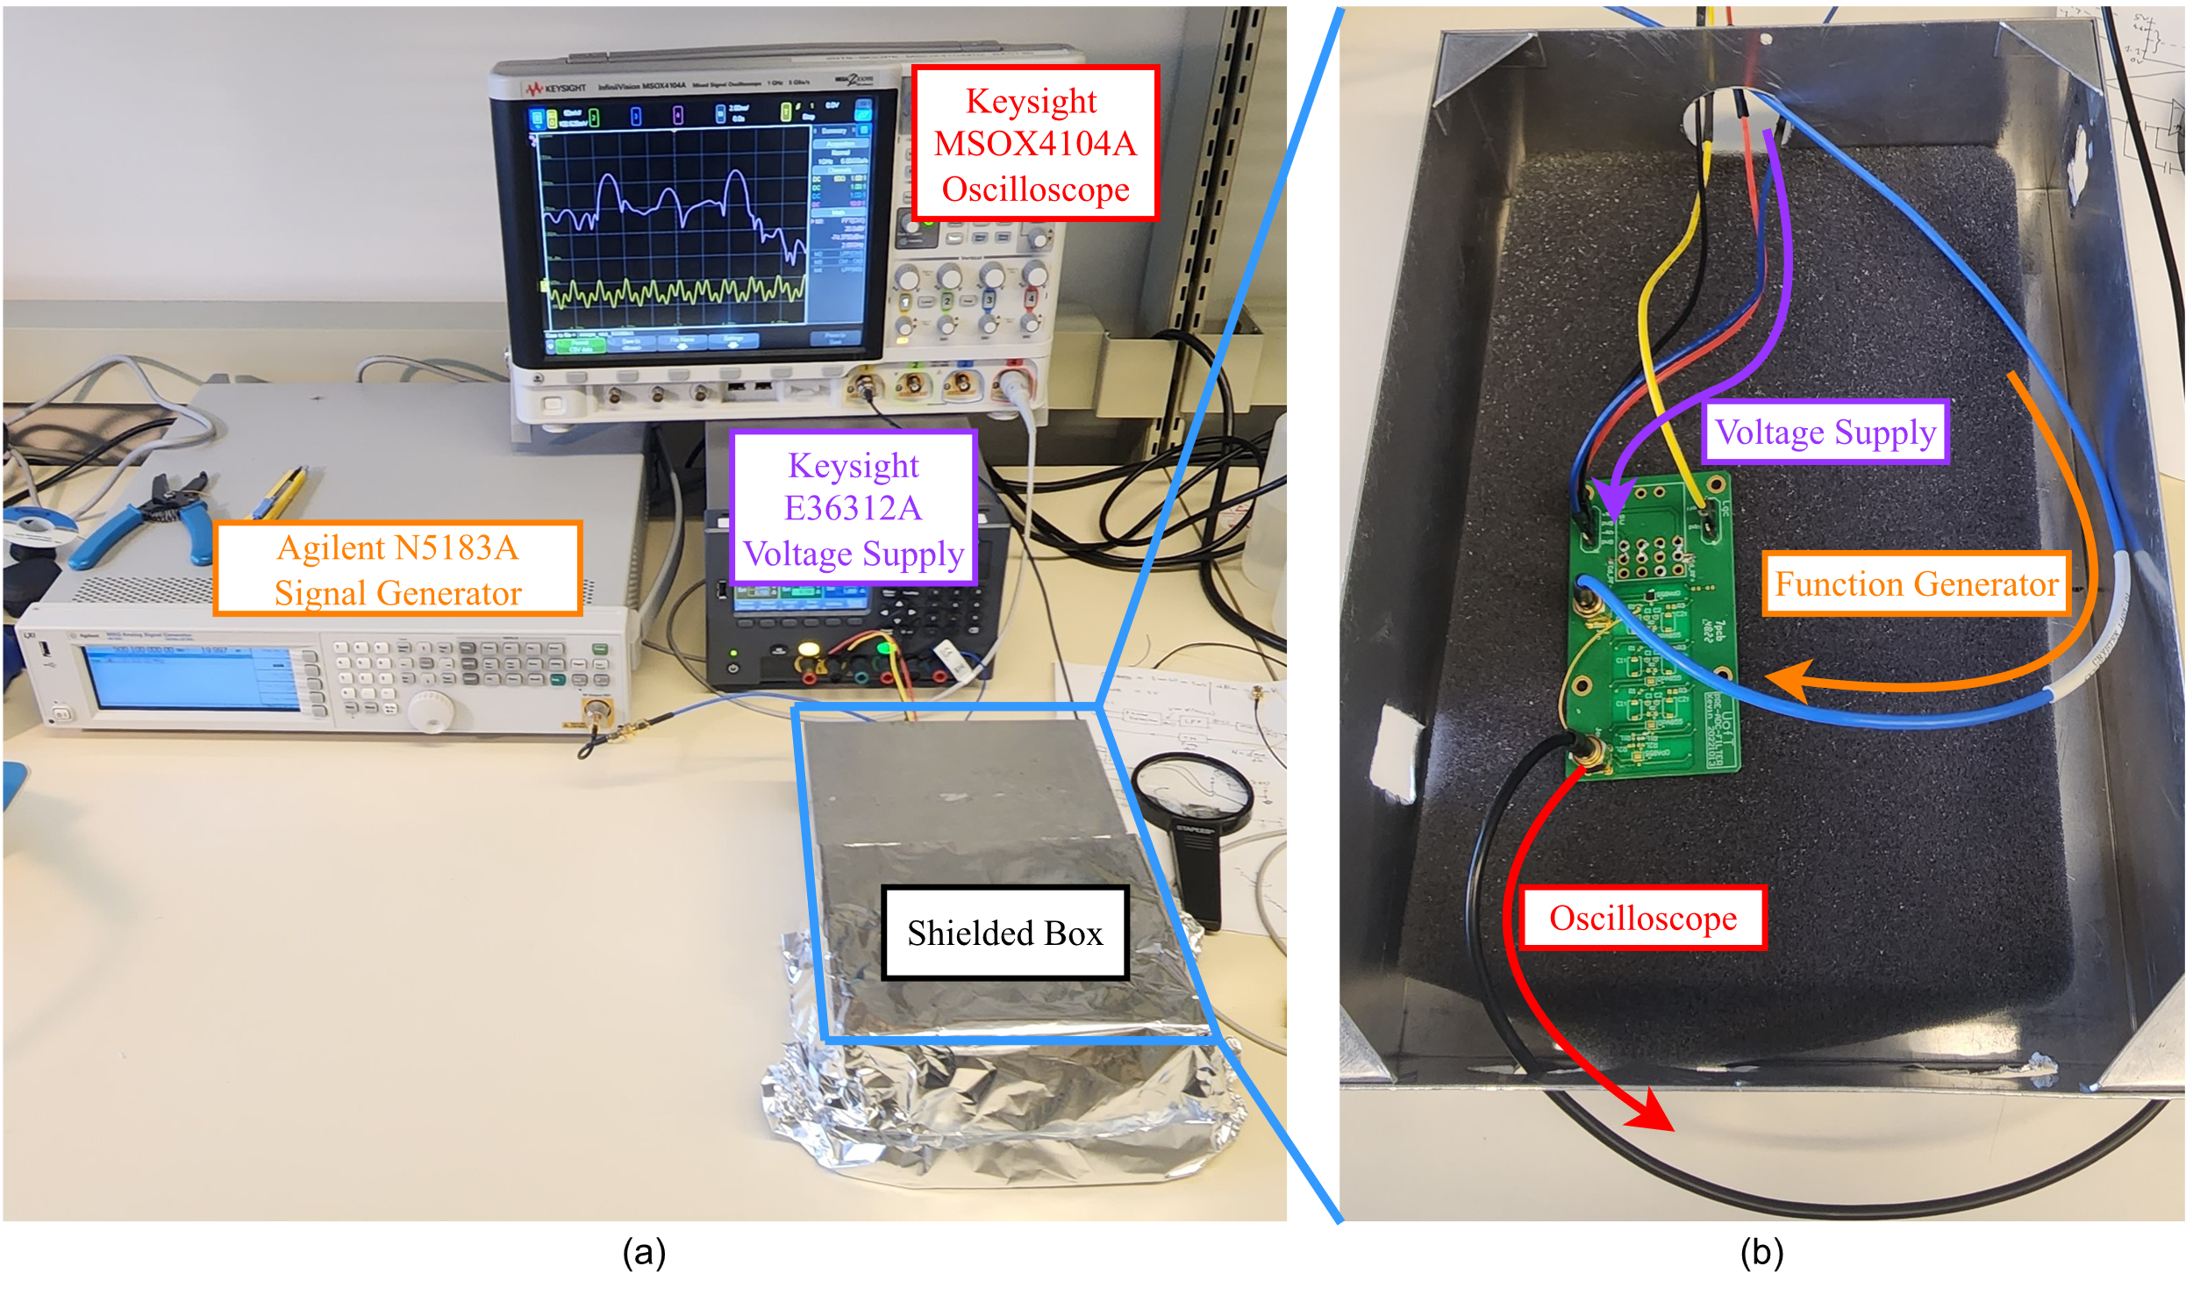
Front-End
Assembly Validation

Slide 44
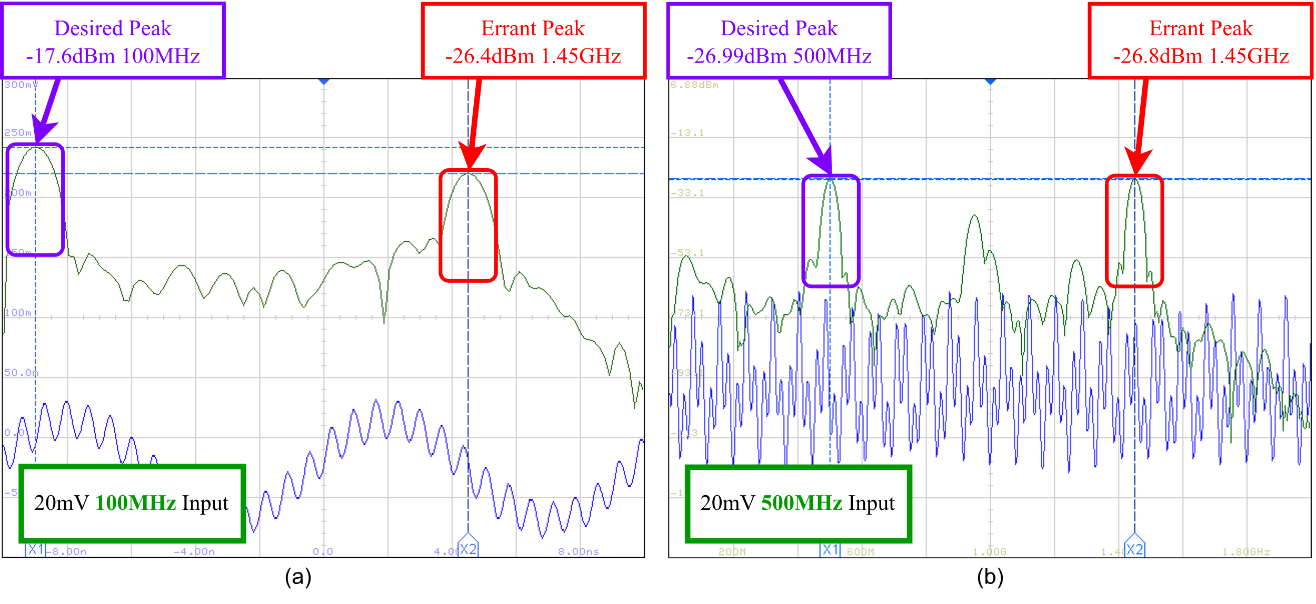
Front-End
Input Buffer Validation

Slide 45
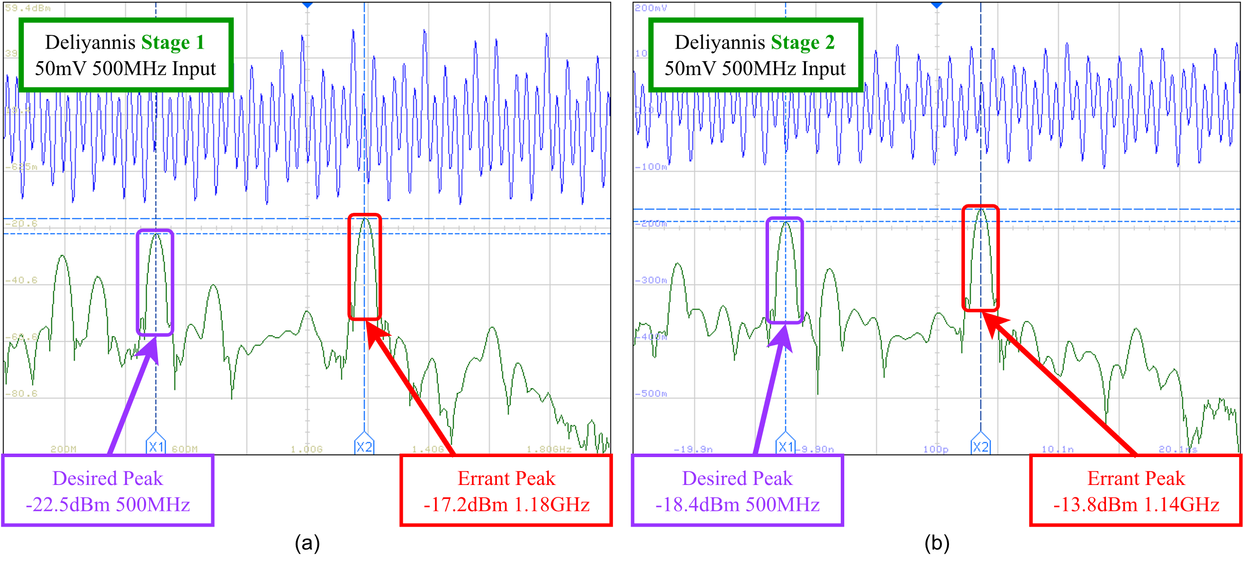
Front-End
Deliyannis Validation

Slide 46
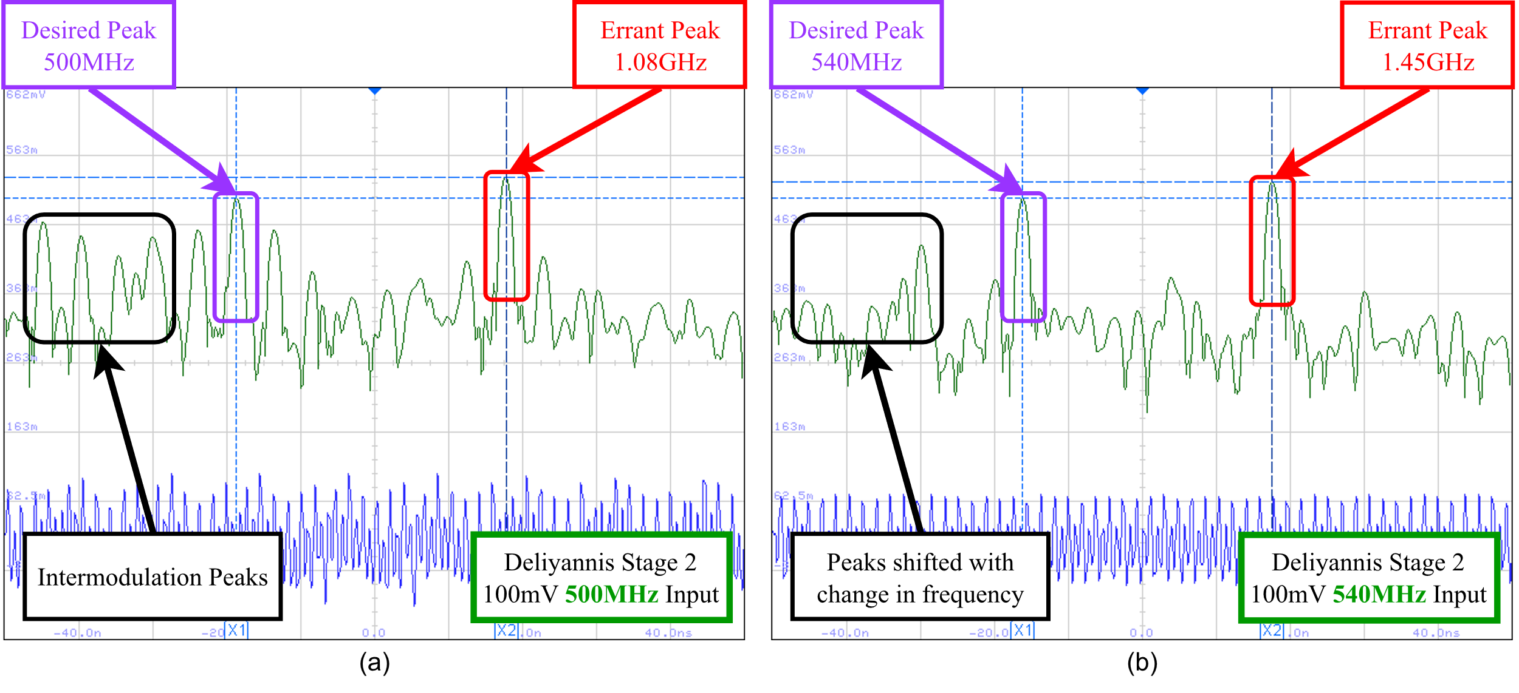
Front-End
Deliyannis Validation

Slide 47
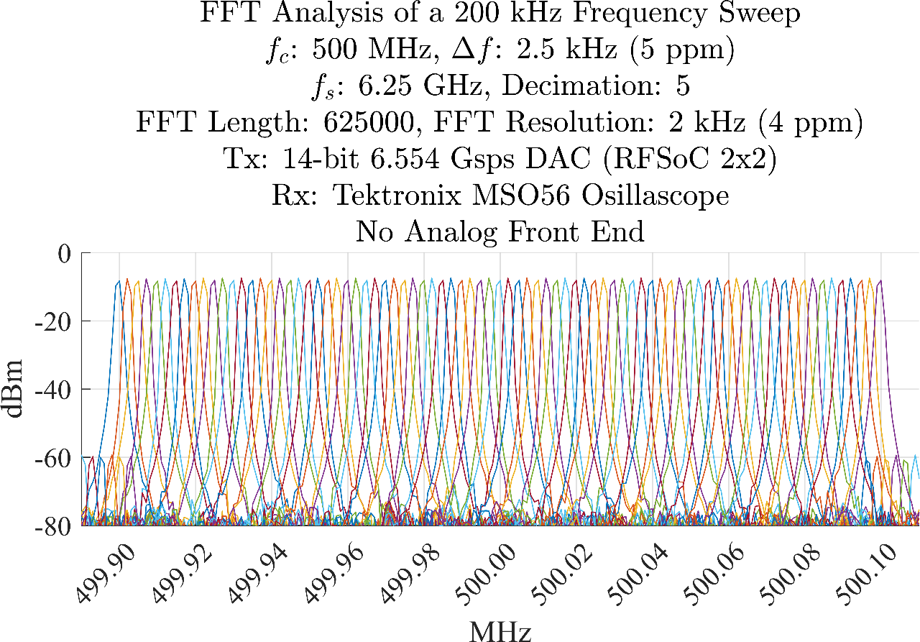
Back-End
Back-End Validation

Slide 48
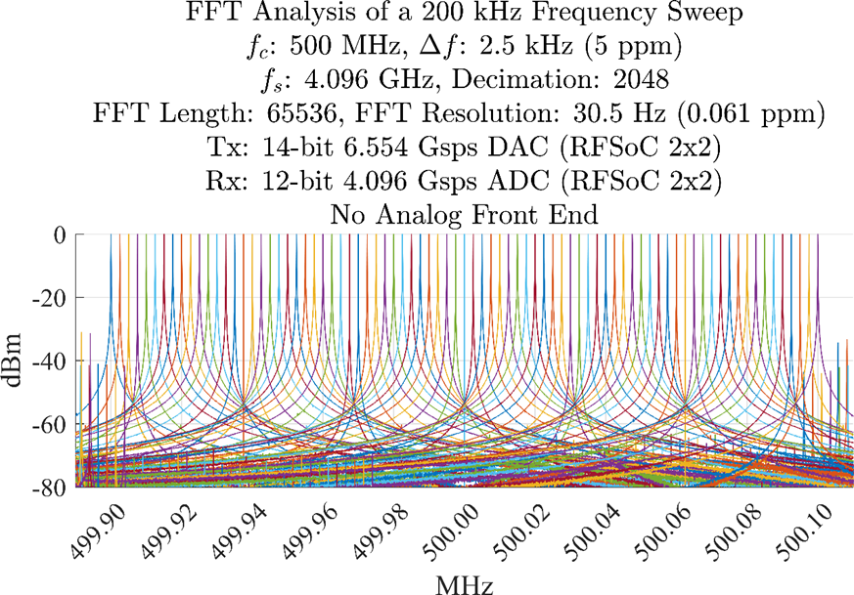
Back-End
Back-End Validation

